Slide 1
The reaction-diffusion system: a mechanism for autonomous pattern formation in the animal skin
Shigeru Kondo
Genes to Cells, 2002
March 27, 2012
Foundations of Mathematical Biology –MATH 637
Saumya Puthenveettil

Slide 2
Background
Reaction-Diffusion (RD) system can form spatial patterns (Turing 1952)
RD system forms periodic patterns
Two chemical substances interact with one another, with different diffusion rates (activator and inhibitor)
Turing believed this may provide information about the development of an embryo

Slide 3
Background
Morphogen: substance that controls tissue development
Assumed that genes act merely as catalysts for spontaneous chemical reactions which regulate the production of morphogens.
Cells differentiate as a result of morphogen concentrations
Morphogenesis : development of shape or form

Slide 4
Morphogenesis
Random initial conditions can cause spontaneous spreading and reacting of chemicals
Turing stated cells differentiate according to morphogen concentration
Activator and inhibitor diffuse into neighboring cells due to concentration gradient

Slide 5
Example Cont’d
Question: How can a spherical egg become an organism such as a horse or human?
“ It is important that there are some deviations, for the system may reach a state of instability in which these irregularities tend to grow”
Without instability, the egg will stay in its spherical state forever

Slide 6
Background
RD reaction – in the presence of diffusion leads to instability ( Turing bifurcation leads to patterns)
The pace of diffusions (unequal) causes instability
RD reactions are a simplification of the actual processes occurring between cells (mechanical/electrical)
Missionaries and Cannibals example

Slide 7
Diffusion=movement of cannibals and missionaries
Cannibal dominance one color, Missionary dominance another color
RD kept out of equilibrium by fresh chemicals continuously fed into system
Once fresh chemicals start, system returns to equilibrium

Slide 8
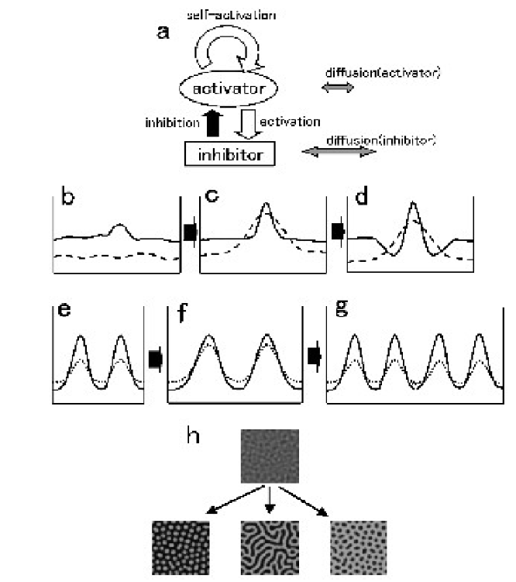
Background

Slide 9
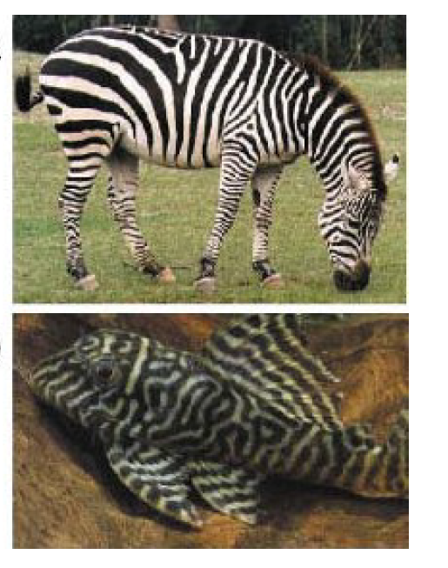
Background
Skin pattern preferred over embryo for experimental testing of RD system since its noninvasive
In mammals RD mechanism inactive, in fish it is active

Slide 10

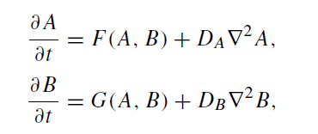
Morphogenesis
D_{B}>D_{A}
Reaction and Diffusion Equations for activator and inhibitor

Slide 11
MODEL
Suppose:
∂u/ ∂t= 0.6u-v-u³ +0.0002 ∂²u/ ∂x²
∂v/ ∂t= 1.5u-2v +0.01 ∂²v/ ∂x²
Activator and Inhibitor interact in each element
Activator and Inhibitor interact with their neighboring elements

Slide 12
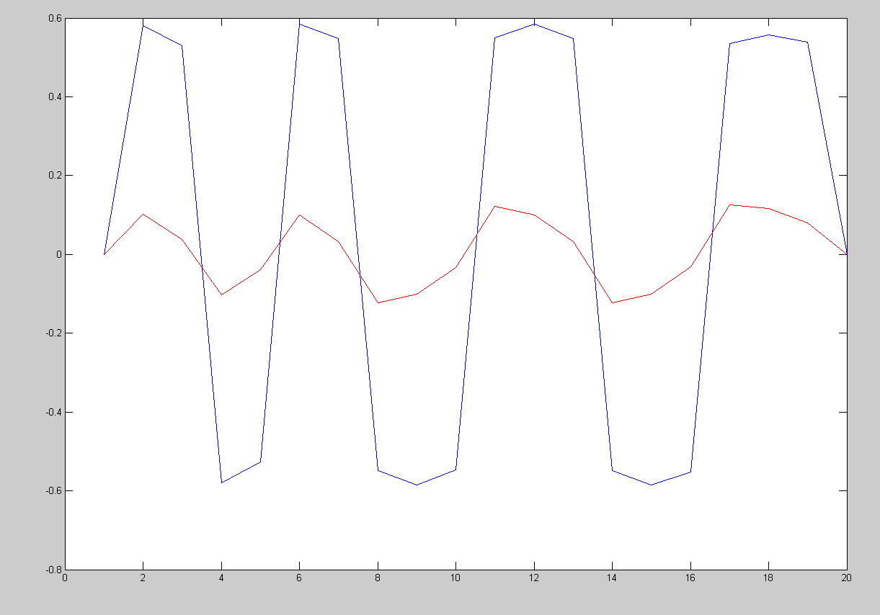
MODEL

Slide 13
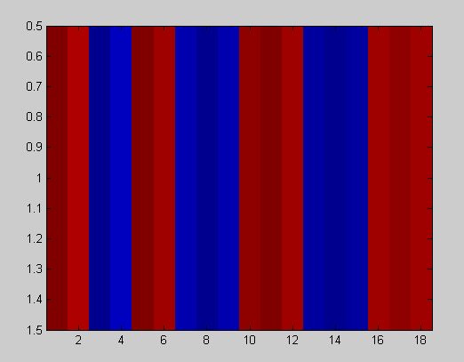
MODEL
Activator

Slide 14
Example : Vascular Mesenchymal Cells
In an embryo, mesenchymal cells organize into different shapes and sizes to form patterns of tissues ( ribs, vertebrae)
VMC’s differentiate into other cell types
Resulting tissue forms patterns
When culturing VMCs there is no pattern
After ~20 days, the cells spread and organize into patterns

Slide 15
VMC’S
Day 1: VMC’s show no pattern – scattered (a)
Day 4: VMC’s align with neighbors into “swirls” (b)
Day 10, cells aggregate into stripe-like ridge pattern(c)
Several days, ridges connect (d)
Cells reorient themselves suggesting chemotaxic migration

Slide 16
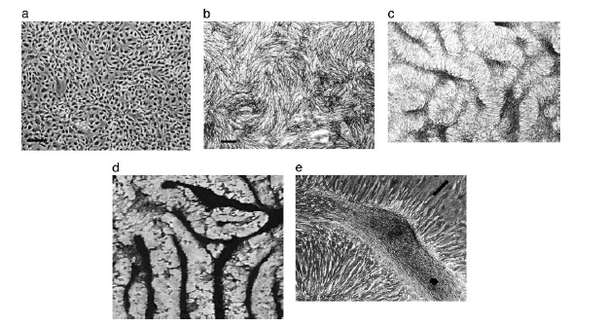
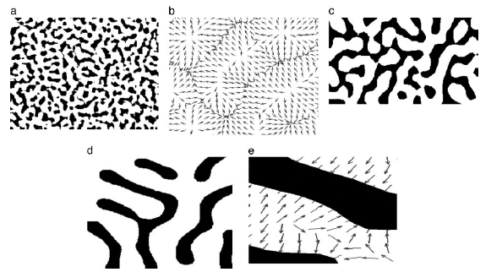
Morphogenesis
In VMC’s BMP-2 is a powerful morphogen and chemoattractant
MGP is the inhibitor
BMP-2 is expected to diffuse more slowly than MGP

Slide 17
Summary
Other models formed angiogenesis, blood coagulation, bone, and tooth formation
Obstacle to modeling patterns in physiology is identifying the activator and inhibitor that is involved in the patterns

Slide 18
References
Murray, J.D. (2003). Mathematical Biology II: Spatial Models and Biomedical Applications. Springer-Verlag, Berlin
Garfinkel A, Tintut Y, Petrasek D, Bostrom K, & Demer LL (2004) Pattern formation by vascular mesenchymal cells. Proceedings of the National Academy of Sciences of the United States of America 101(25):9247-9250.
Meinhardt H, AJ Koch (1994) Biological Pattern Formation: From basic mechanism to complex structures Reviews of Modern Physics 66(4).
4. Turing AM (1990) The chemical basis of morphogenesis. 1953. Bulletin of
mathematical biology 52(1-2):153-197; discussion 119-152.
5. Leppanen T (2004) Computational Studies of Pattern Formation in Turing Systems.
(Helsinki University of Technology).

